Slide 1
IRIS For Health Training
Guillaume Rongier
Sales Engineer

Slide 2
Index
Introduction
Installation
VsCode
Client/Server
Git
Premier flux HL7v2
Service
Router
Operation
DTL
Transformation HL7v2 to FHIR
Introduction
Transformation HL7v2 -> SDA3
En code
Globals
ObjectScript
En graphique
DTL
Transformation SDA3 -> FHIR
Graphique
DTL
Tips and tricks

Slide 3
Introduction

Slide 4
IRIS For Health
Unifier pour Simplifier
Interopérabilité
Stockage
Décisionnel

Slide 5
IRIS Mantra
Bring code to data
Not data to code

Slide 6
Interoperability Framework
Client Applications
Inbound Adapters
Business
Services
Business
Operations
Outbound Adapters
External Applications
Business
Processes
Composite
Applications
Web
SOAP
Java
Federated Databases

Slide 7
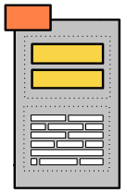
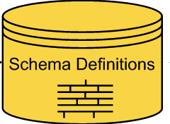
Health Framework
Client Applications
HL7 Inbound Adapter
HL7
Business
Services
HL7
Business
Operations
HL7 Outbound Adapter
External Applications
HL7
Business
Processes
Routing
Rule Sets
Data
Transformations
HL7
Message

Slide 8
Installation

Slide 9
Dockerfile
ARG IMAGE=intersystemsdc/irishealth-community:2020.4.0.547.0-zpm
FROM $IMAGE
ARG IRIS_PASSWORD
USER root
WORKDIR /opt/irisapp
RUN chown ${ISC_PACKAGE_MGRUSER}:${ISC_PACKAGE_IRISGROUP} /opt/irisapp
USER ${ISC_PACKAGE_MGRUSER}
COPY . /opt/irisapp
COPY iris.script /tmp/iris.script
# run iris and initial
RUN iris start IRIS \
&& iris session IRIS < /tmp/iris.script \
&& iris stop IRIS quietly

Slide 10
Iris.script
zn "%SYS"
Do ##class(Security.Users).UnExpireUserPasswords("*")
zn "HSLIB"
// Install a Foundation namespace and change to it
Do ##class(HS.HC.Util.Installer).InstallFoundation("TRAINING")
zn "TRAINING"
// Install FHIR repo
Set appKey = "/api/fhir"
Set strategyClass = "HS.FHIRServer.Storage.Json.InteractionsStrategy"
Set metadataConfigKey = "HL7v40"

Slide 11
Docker-compose
version: '3.6'
services:
iris:
build:
context: .
dockerfile: dockerfile
args:
- IRIS_PASSWORD=$IRIS_PASSWORD
restart: always
env_file:
- .env
ports:
- 32782:1972
- 32783:52773
- 32784:53773
volumes:
- ./:/irisdev/app

Slide 12
Lunch it !
Docker compose up

Slide 13

Premier flux HL7v2

Slide 14
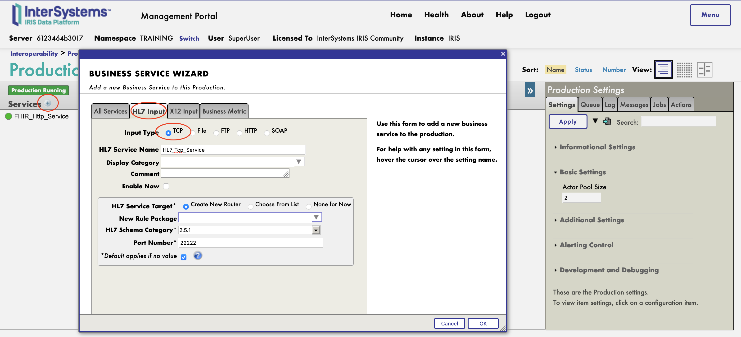
First HL7 TCP Service

Slide 15
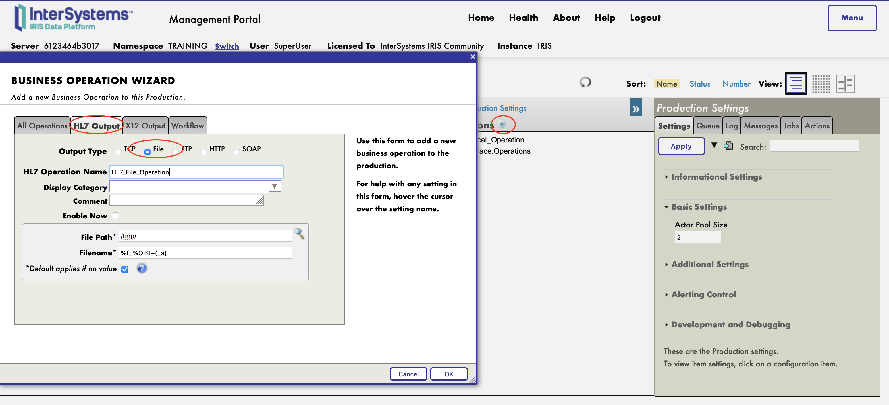
HL7 Operation

Slide 16
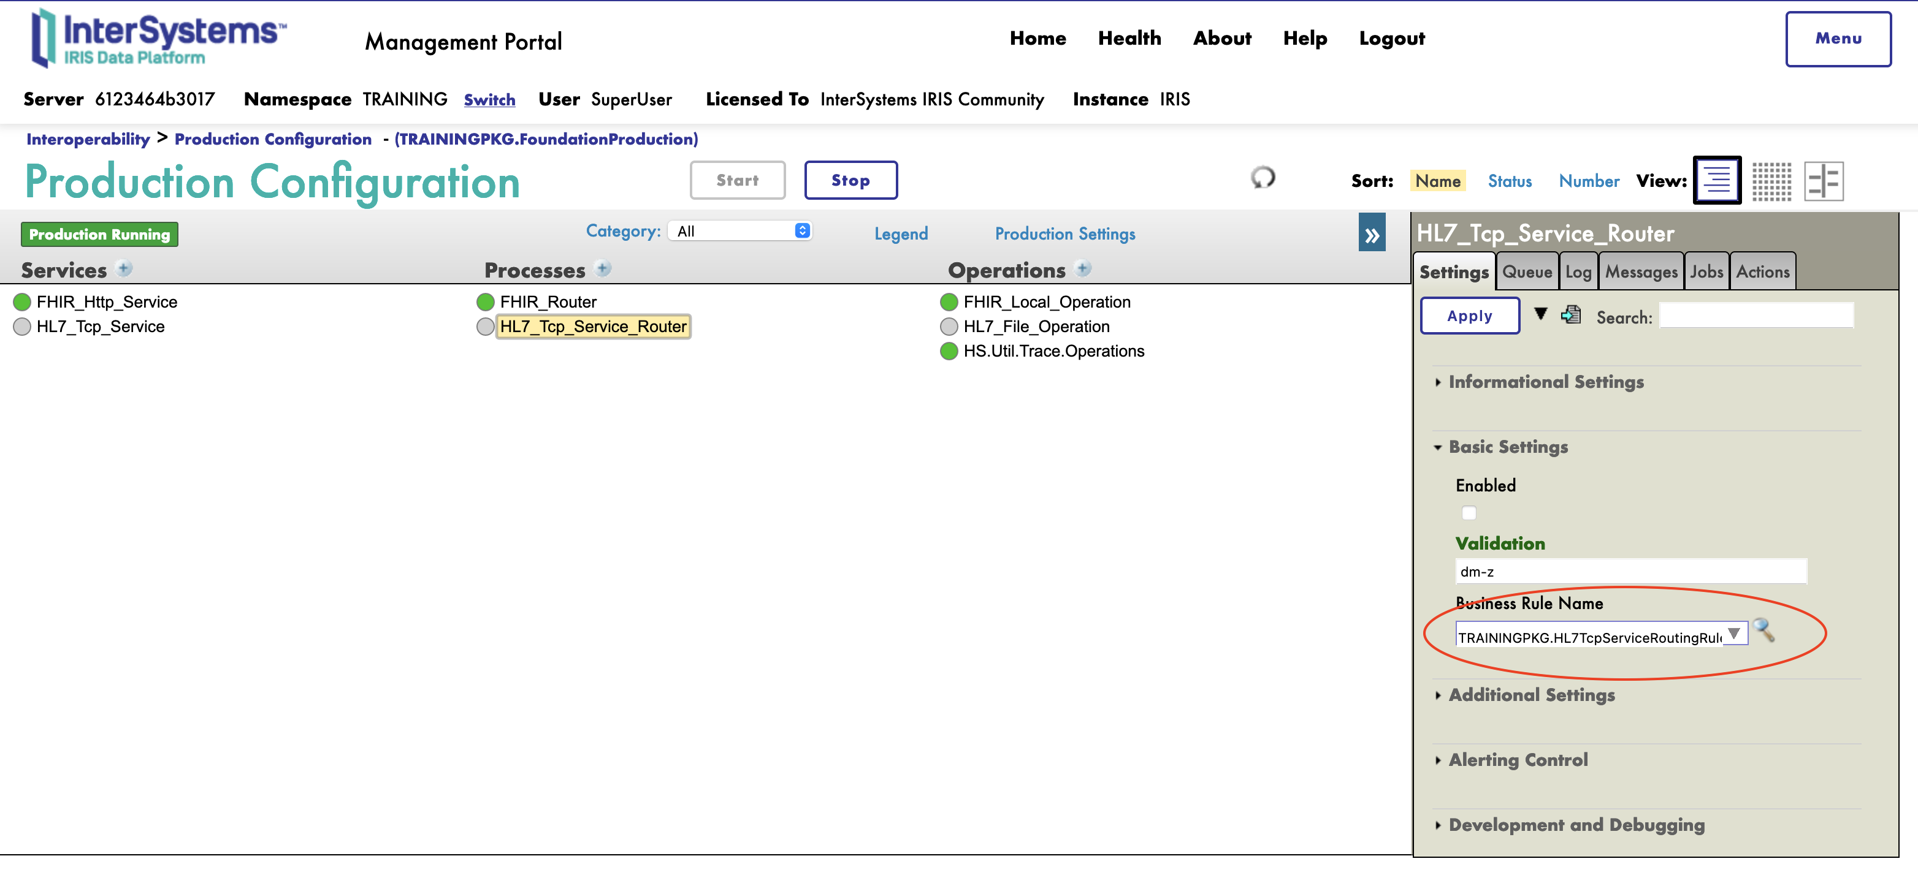
HL7 router

Slide 17
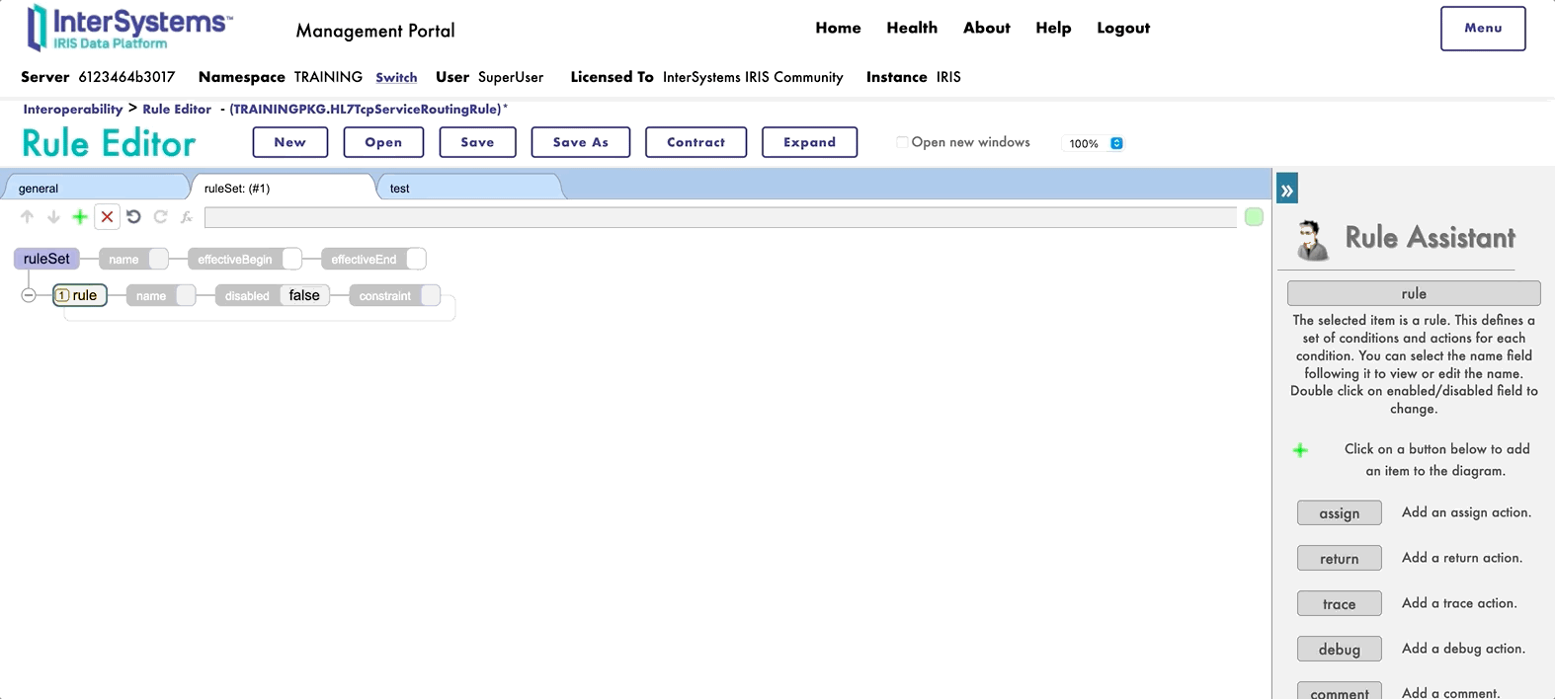
HL7 router

Slide 18
Test It !
Create an Operation
Name : HL7_Tcp_Operation
Port : 2222
Host : localhost

Slide 19
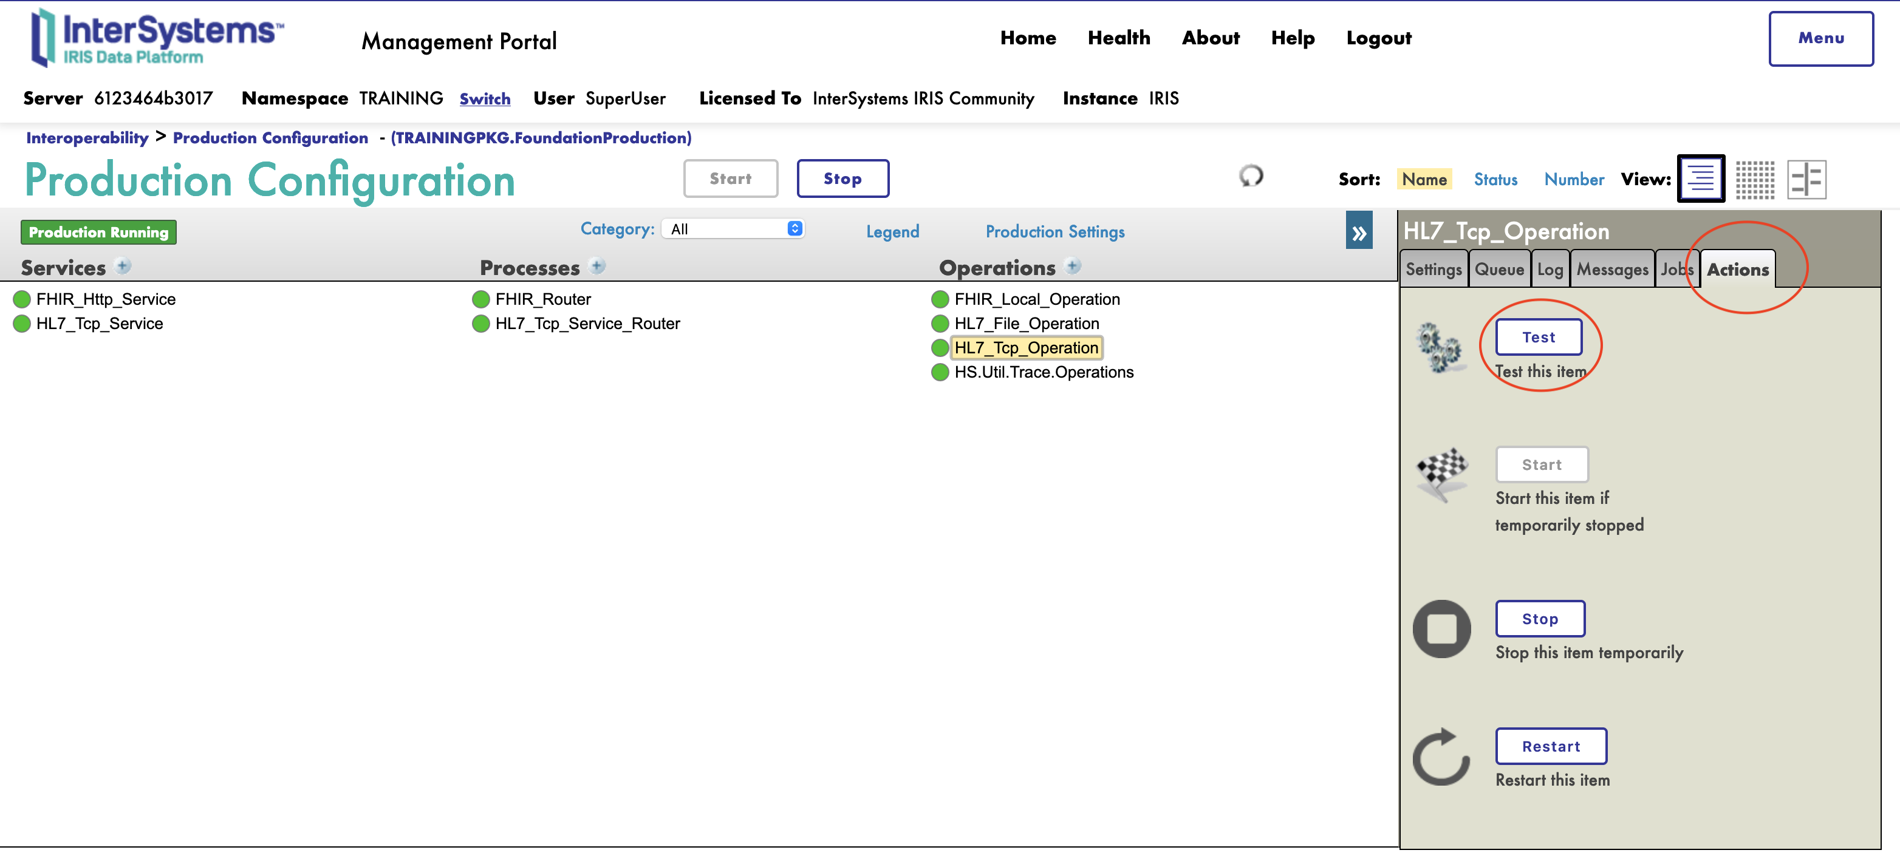
Test It !

Slide 20
Client/Server

Slide 21
Client / Server
Save you work in git.
First remember the mantra :
Bring code to data
Not data to code
Second :
Its a database

Slide 22
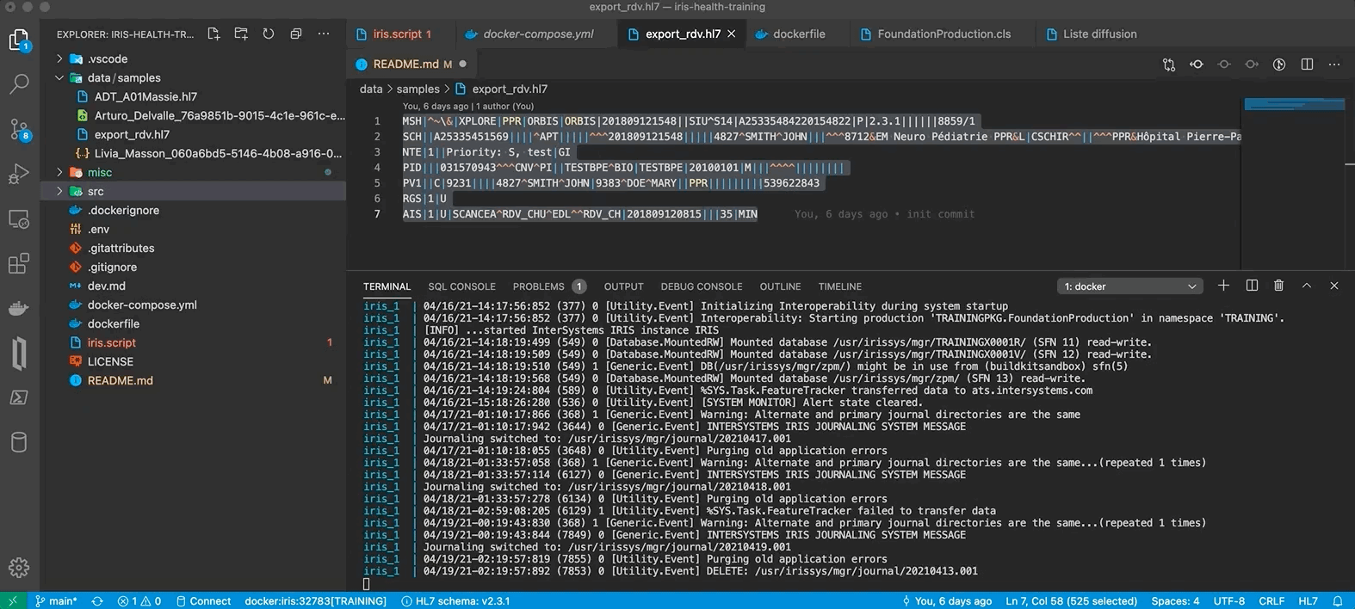
Client / Server

Slide 23
DTL

Slide 24
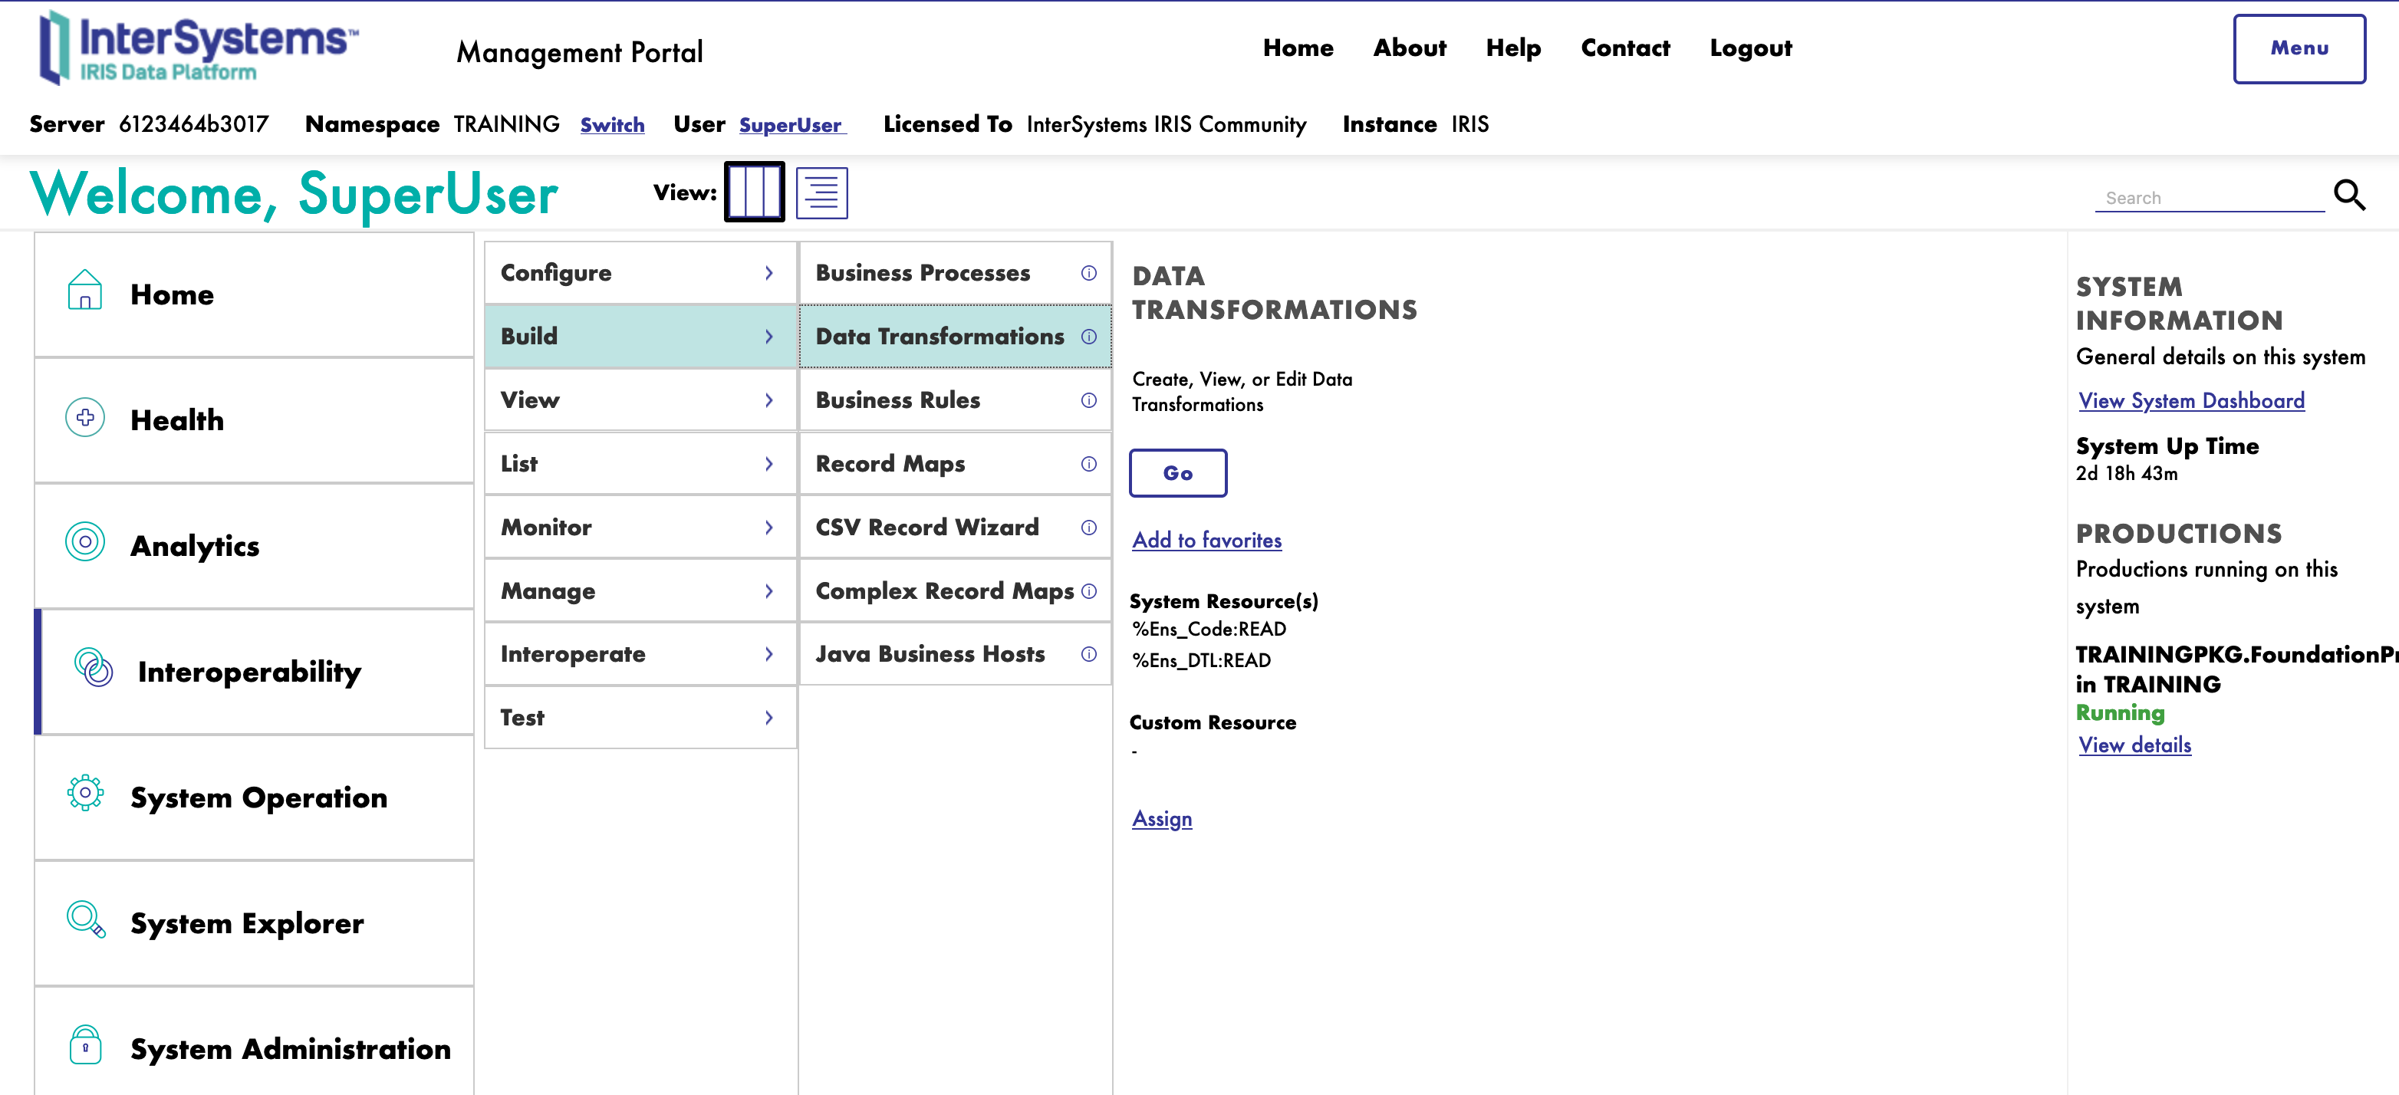
DTL

Slide 25
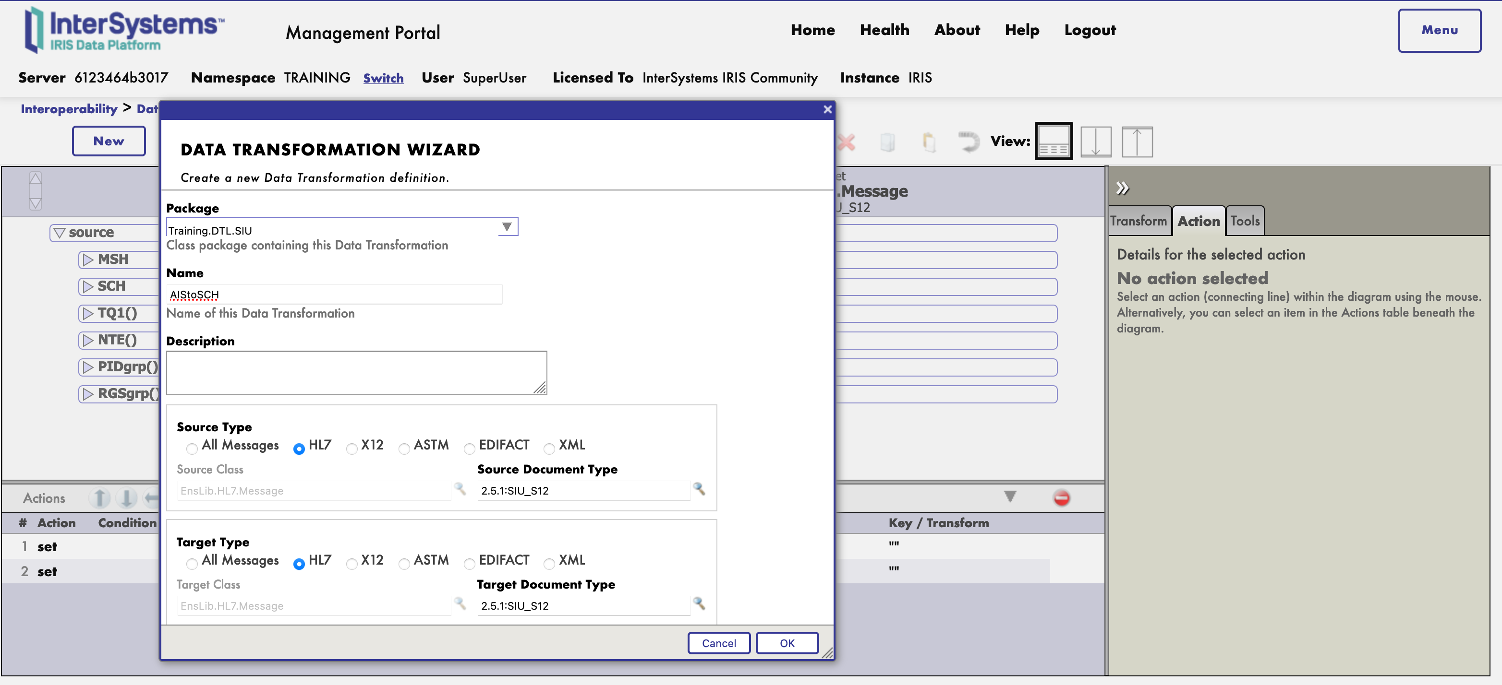
DTL

Slide 26
DTL

Slide 27
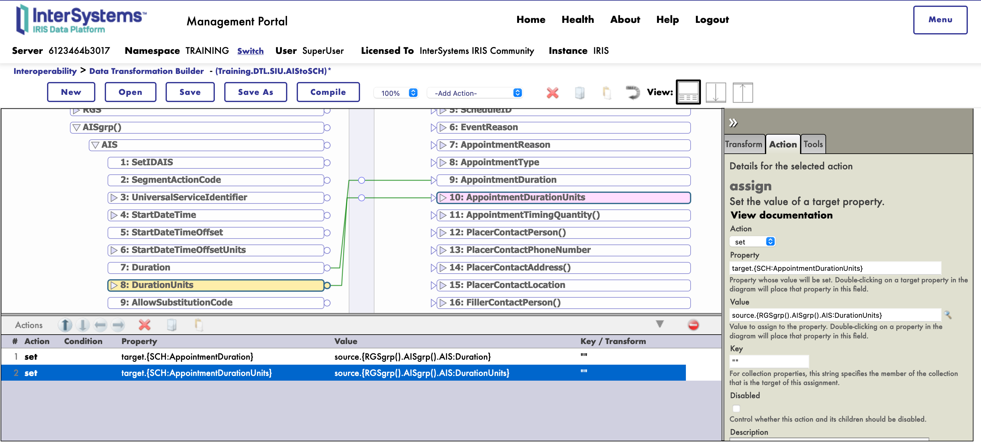
DTL

Slide 28
Test It !
Compile
Test It !
Tools Tab
Test
Add DTL to router
Test It !

Slide 29

HL7v2 To FHIR

Slide 30
Overview, what we have done
BS
RR
File

Slide 31
Overview, what we plan to do
BS
RR
File
HL7 to SDA
SDA to FHIR
FHIR

Slide 32
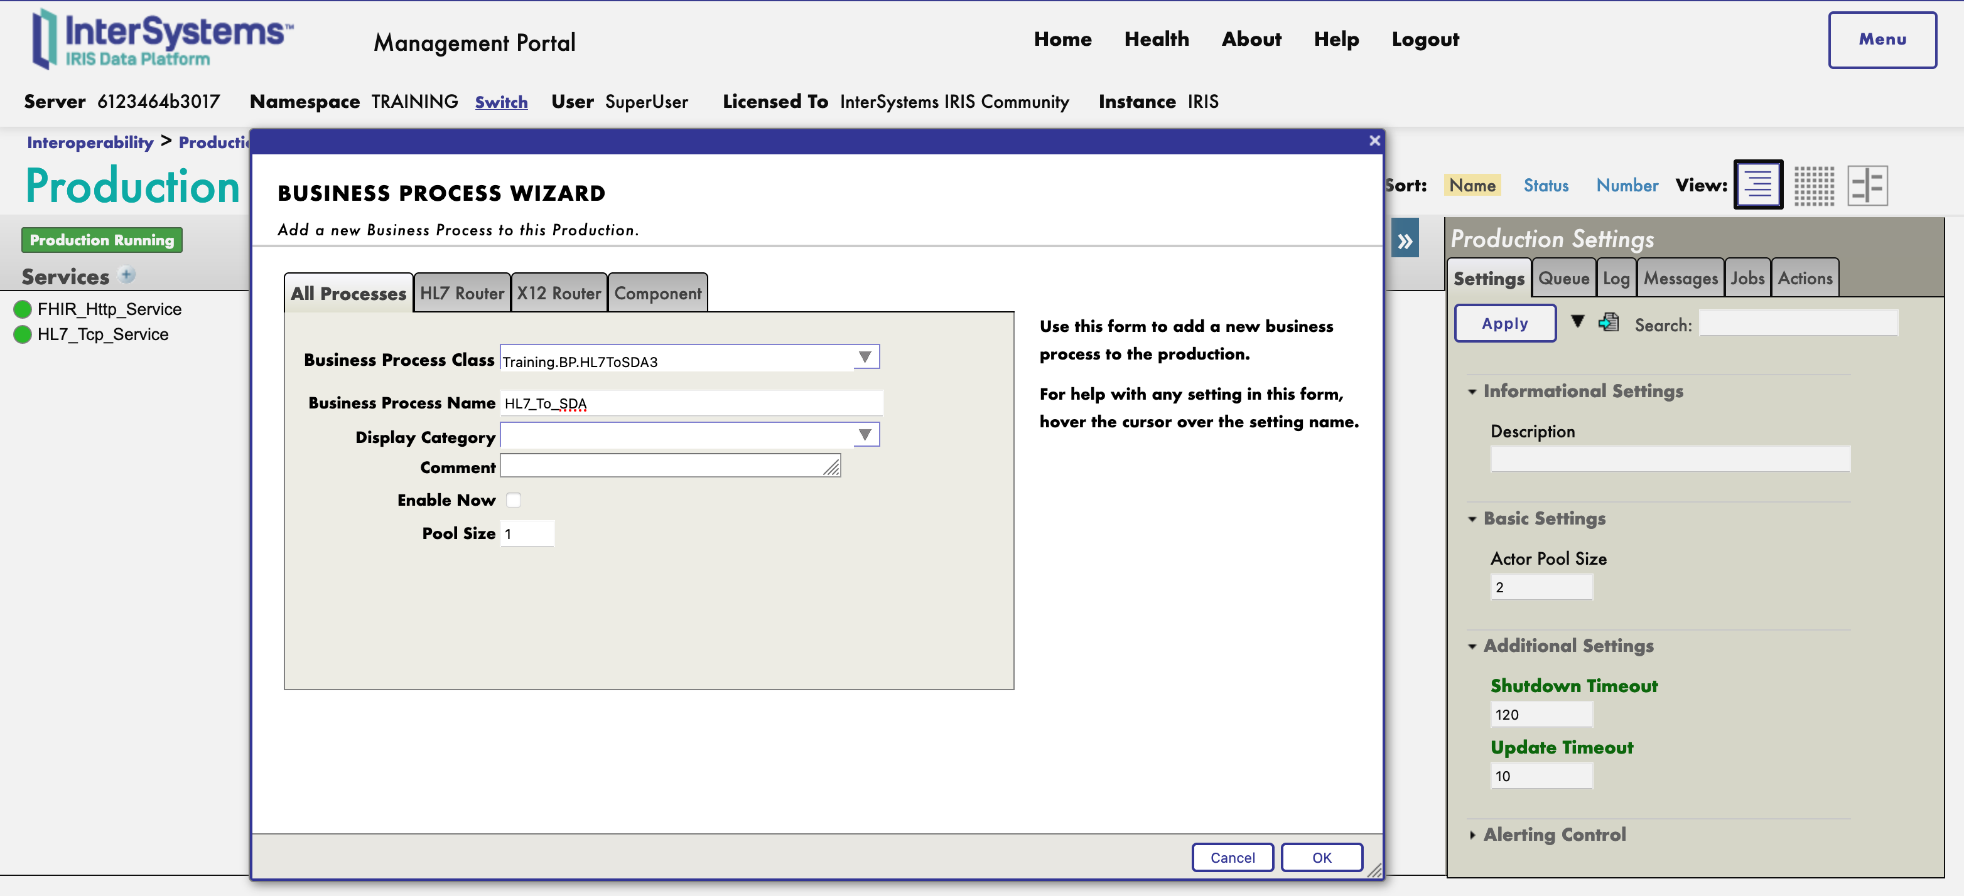
Instantiate the new BPs
Instantiate Training.BP.HL7ToSDA3 as HL7_To_SDA

Slide 33
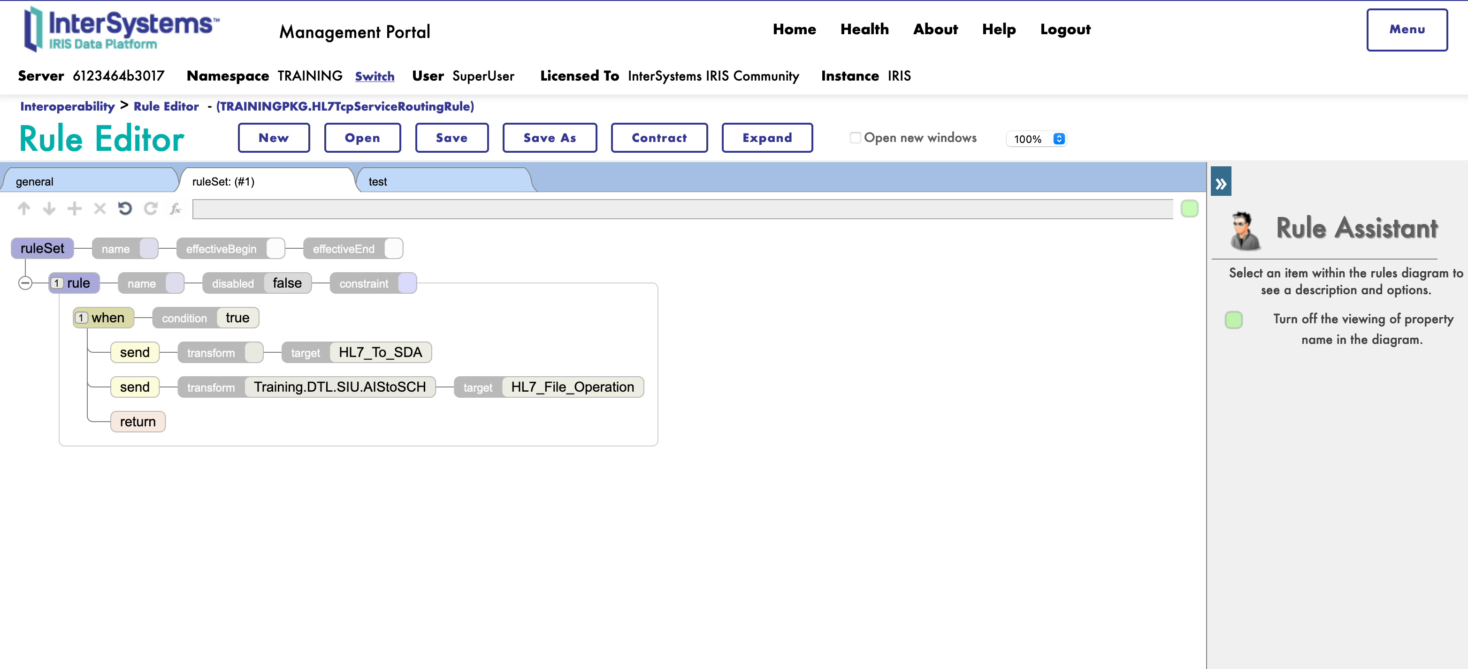
Instantiate the new BPs
Instantiate HS.FHIR.DTL.Util.HC.SDA3.FHIR.Process as SDA_To_FHIR
Add route to HL7_To_SDA to TRAININGPKG.HL7TcpServiceRoutingRule

Slide 34
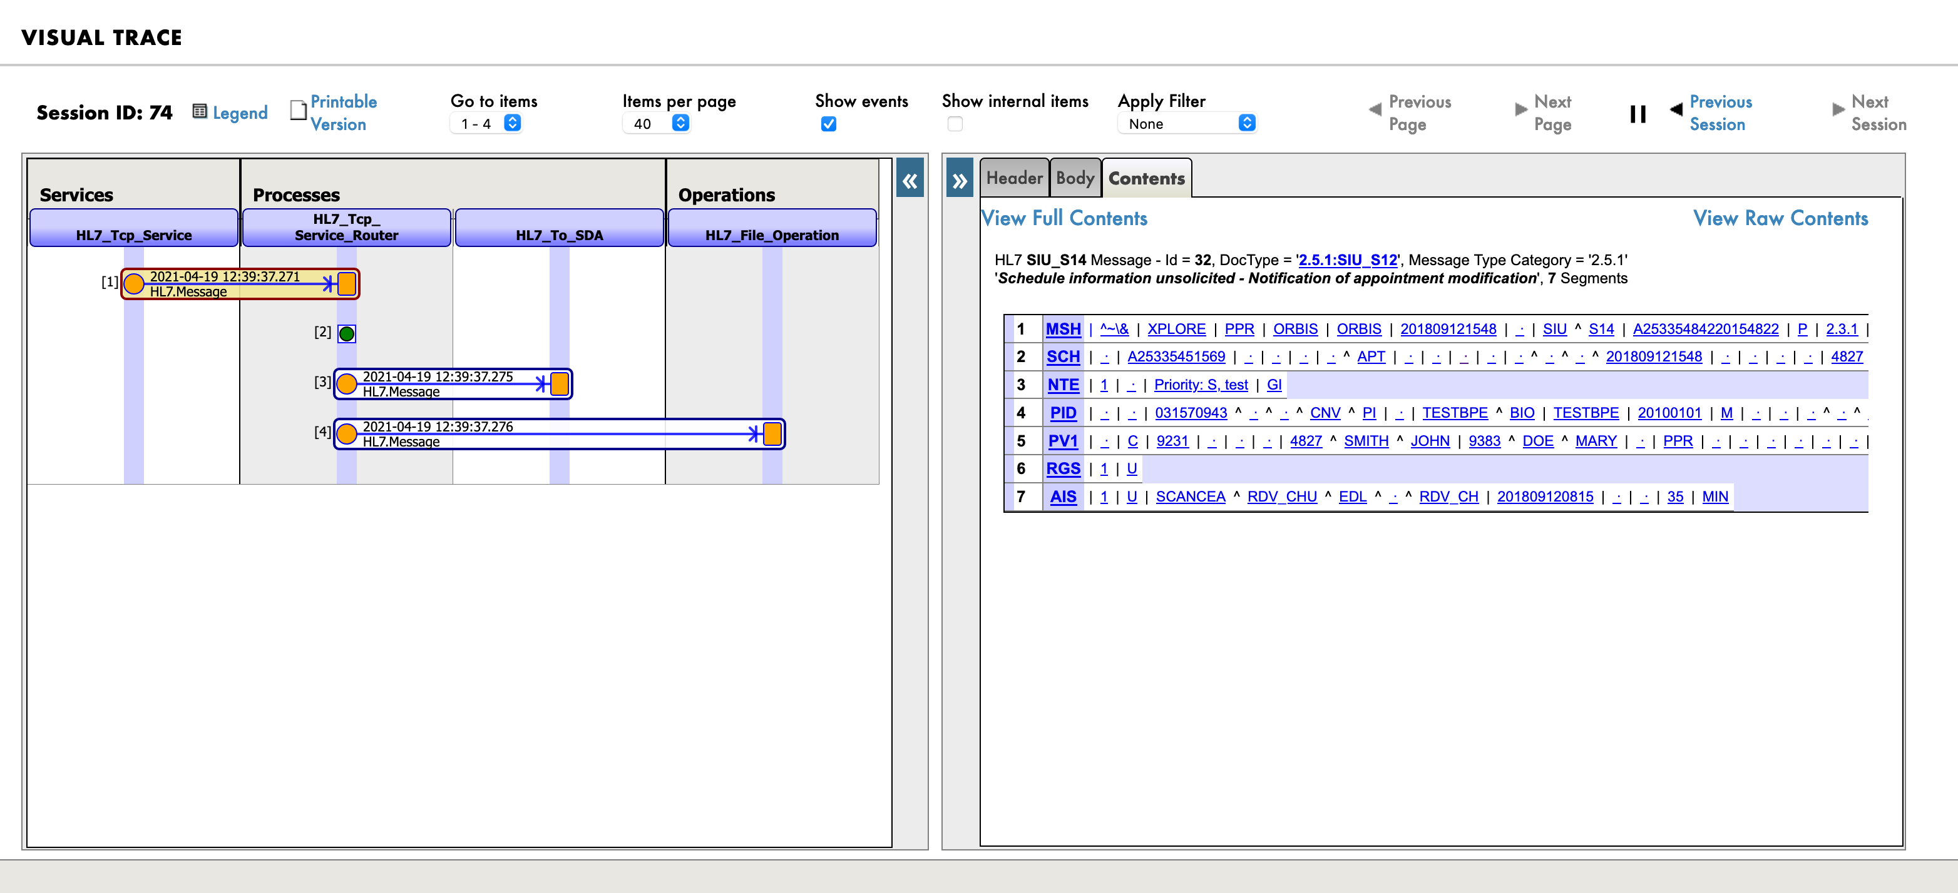
Test It !
What happen ?

Slide 35
Use the helper tools in Training.BP.HL7ToSDA3
The helper is Training.Tools.HL7toSDA3Demographics who extends HS.Hub.Standalone.HL7.HL7ToSDA3
/// Transforms an HL7 message to SDA, an internal healthcare format for InterSystems IRIS for Health.
Method OnRequest(pRequest As EnsLib.HL7.Message, Output pResponse As Ens.Response) As %Status
{
set tSC = $$$OK
try {
//set tSC = ##class(Training.Gateway.HL7.HL7ToSDA3).GetSDA(pRequest,.tSDA)
//set tSC= ##class(Training.Hub.Standalone.HL7.HL7ToSDA3).GetSDAContainer(pRequest,.tContainer)
//set tSC = tContainer.ToQuickXMLStream(.tSDA)
//set tSC = ..SendRequestSync(..TargetConfigName,##class(Ens.StreamContainer).%New(tSDA),.pResponse)
} catch ex {
set tSC = ex.AsStatus()
}
quit tSC
}
/// Transforms an HL7 message to SDA, an internal healthcare format for InterSystems IRIS for Health.
Method OnRequest(pRequest As EnsLib.HL7.Message, Output pResponse As Ens.Response) As %Status
{
set tSC = $$$OK
try {
//set tSC = ##class(Training.Gateway.HL7.HL7ToSDA3).GetSDA(pRequest,.tSDA)
set tSC= ##class(Training.Tools.HL7toSDA3Demographics).GetSDAContainer(pRequest,.tContainer)
set tSC = tContainer.ToQuickXMLStream(.tSDA)
set tSC = ..SendRequestSync(..TargetConfigName,##class(Ens.StreamContainer).%New(tSDA),.pResponse)
} catch ex {
set tSC = ex.AsStatus()
}
quit tSC
}

Slide 36
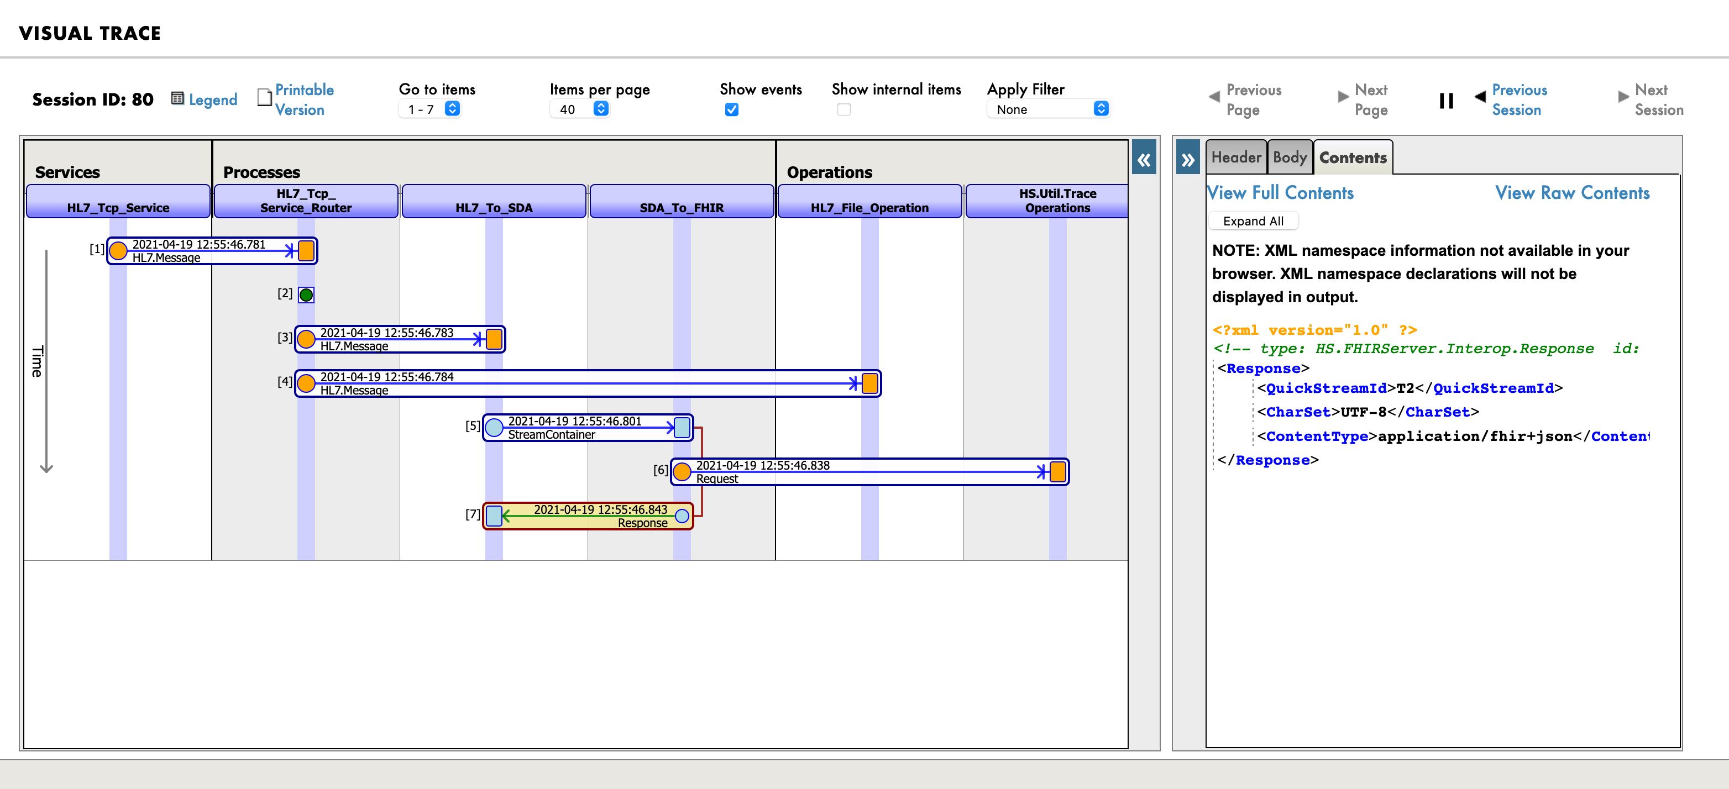
Test It !
What happen ?

Slide 37

Plugins

Slide 38

CI/CD

